Slide 1

ONE STOP SOLUTIONS
The quintessential destination you’ve been seeking
An educational purpose website
Developed and maintained by:
Raghav Kumar (12217111) Hitesh Bhandari (12220814)

Slide 2
PURPOSE & MOTTO
To overcome following adversities :
Hassle and time waste
Insufficient resource retrieval
Limited availability

Slide 3
TECHSTACK
HTML 5 Requisite: Basic structure of website
CSS 3 Requisite: Beautify the appearance
JavaScript Requisite: Dynamics and animations
JQuery Requisite: Wrapping multiple lines of JavaScript
Bootstrap Requisite: Responsive development

Slide 4
MERITS & OFFBEATS
Centralized Access (USP) Access of resources (Notes, Books, PDFs, YT lectures) at one platform !
Collaborative Learning
User-Friendly Interface Intuitive, quick and efficient experience
Adaptive to curriculum Aligned with academic standards and syllabus of Institution

Slide 5
Let’s delve into the website !

Slide 6
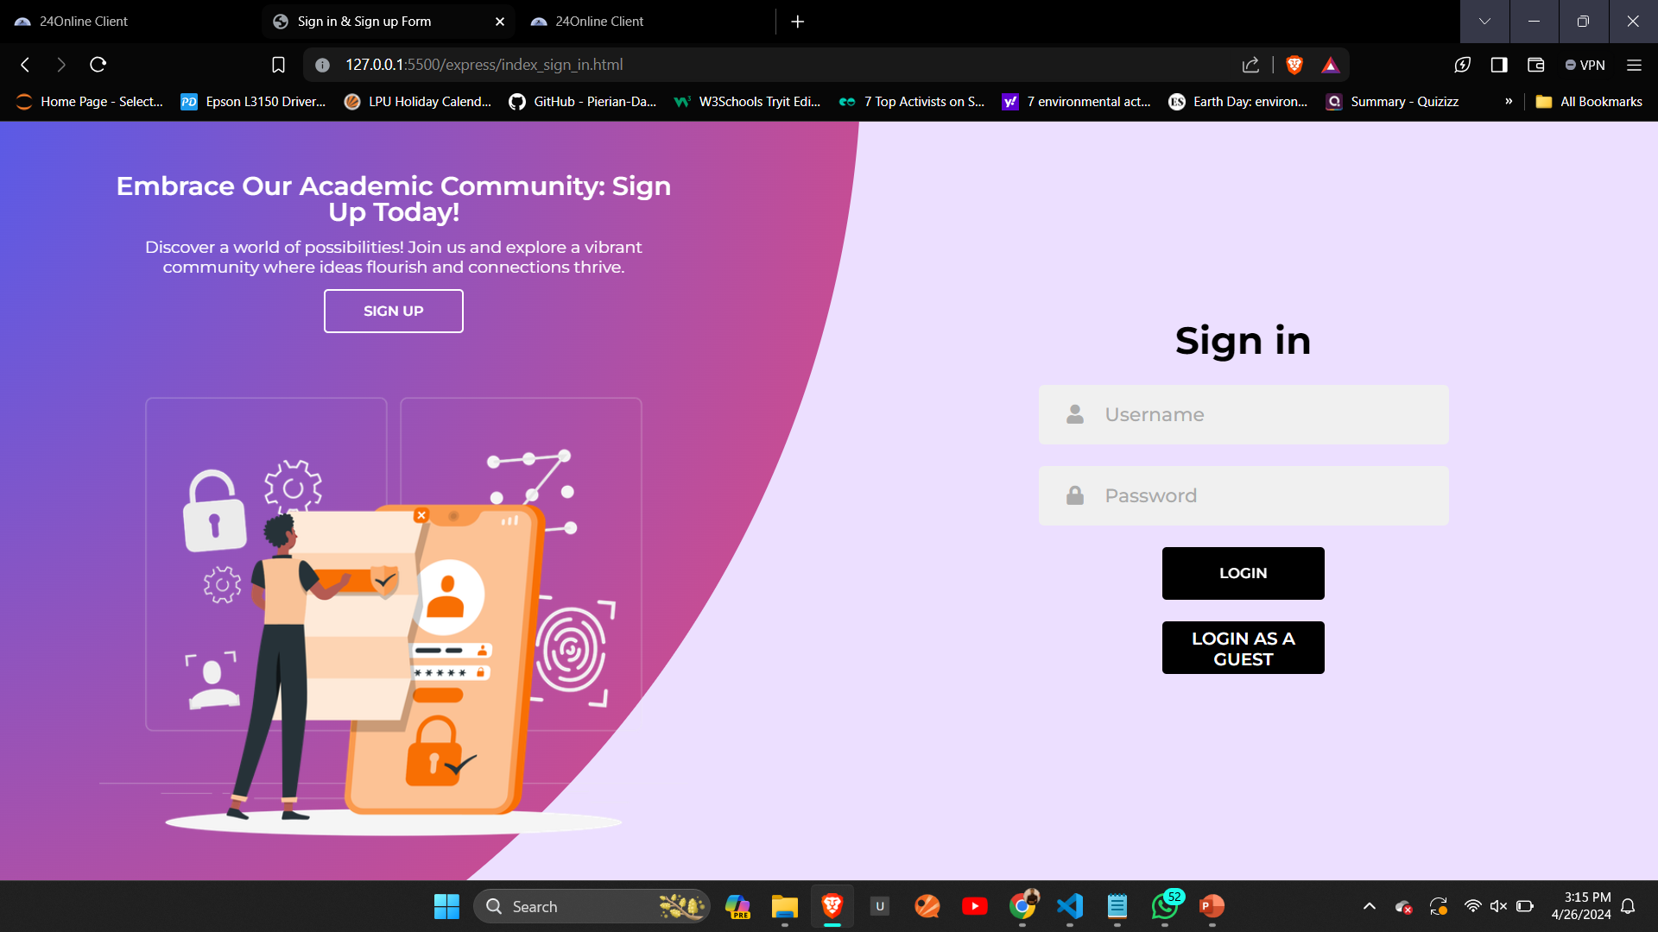

Slide 7
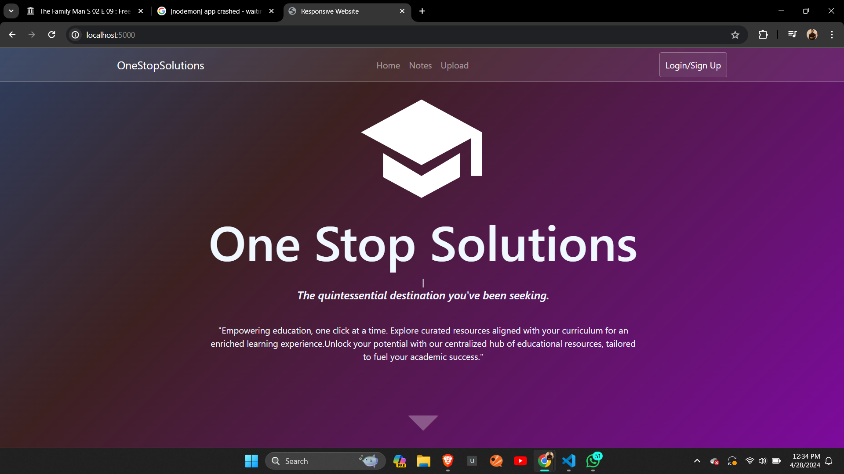

Slide 8
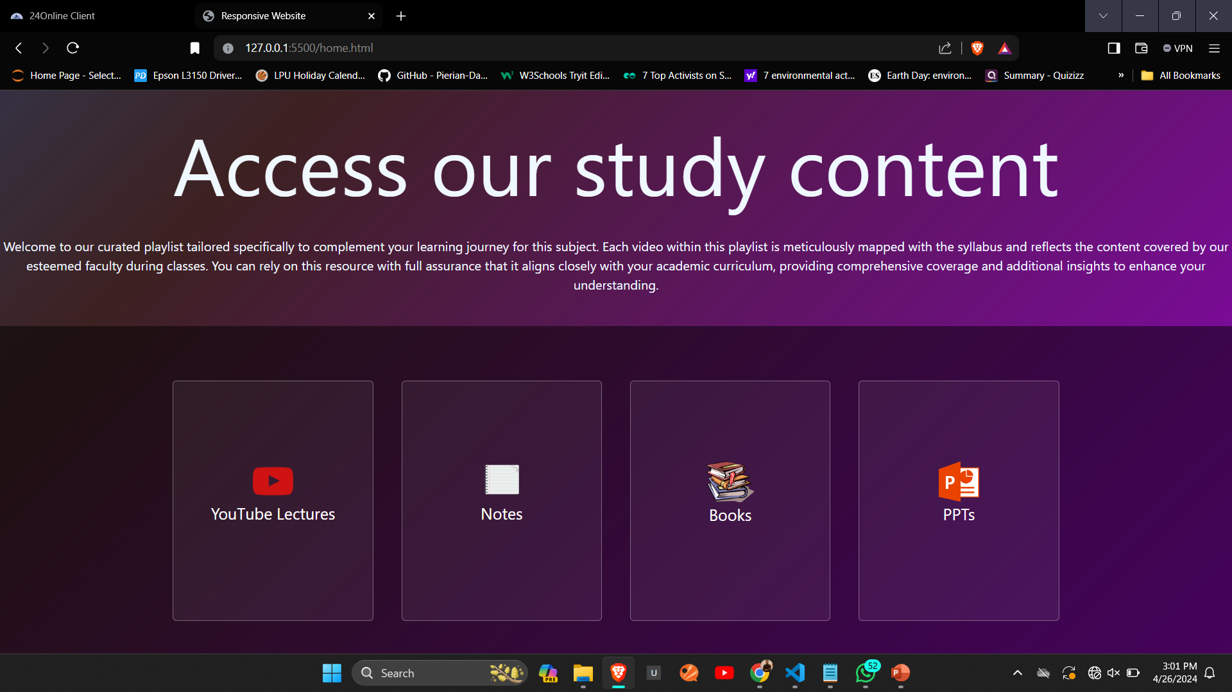

Slide 9
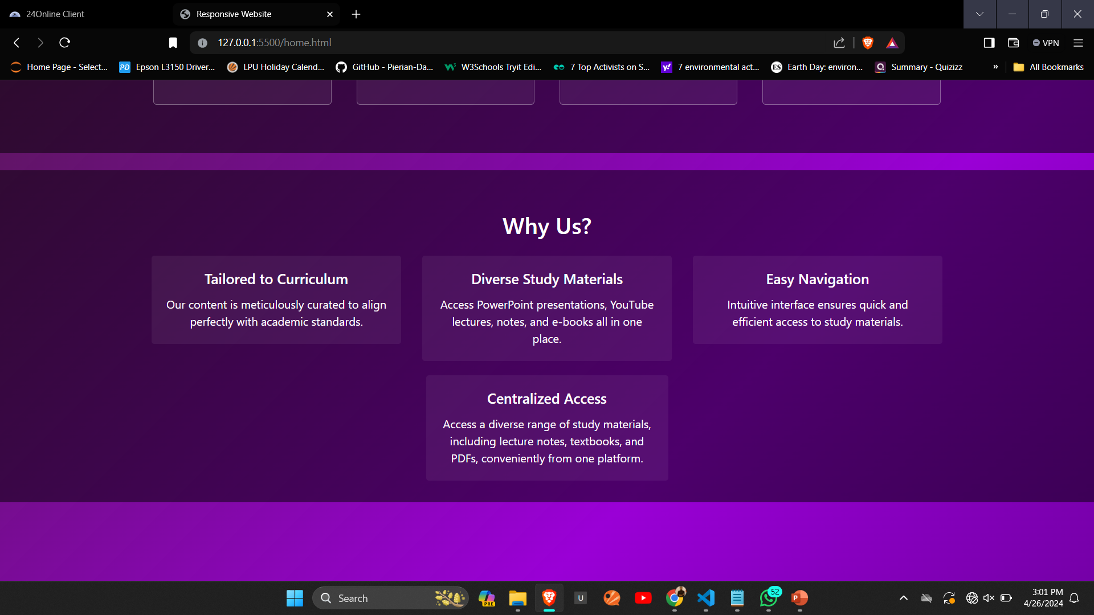

Slide 10
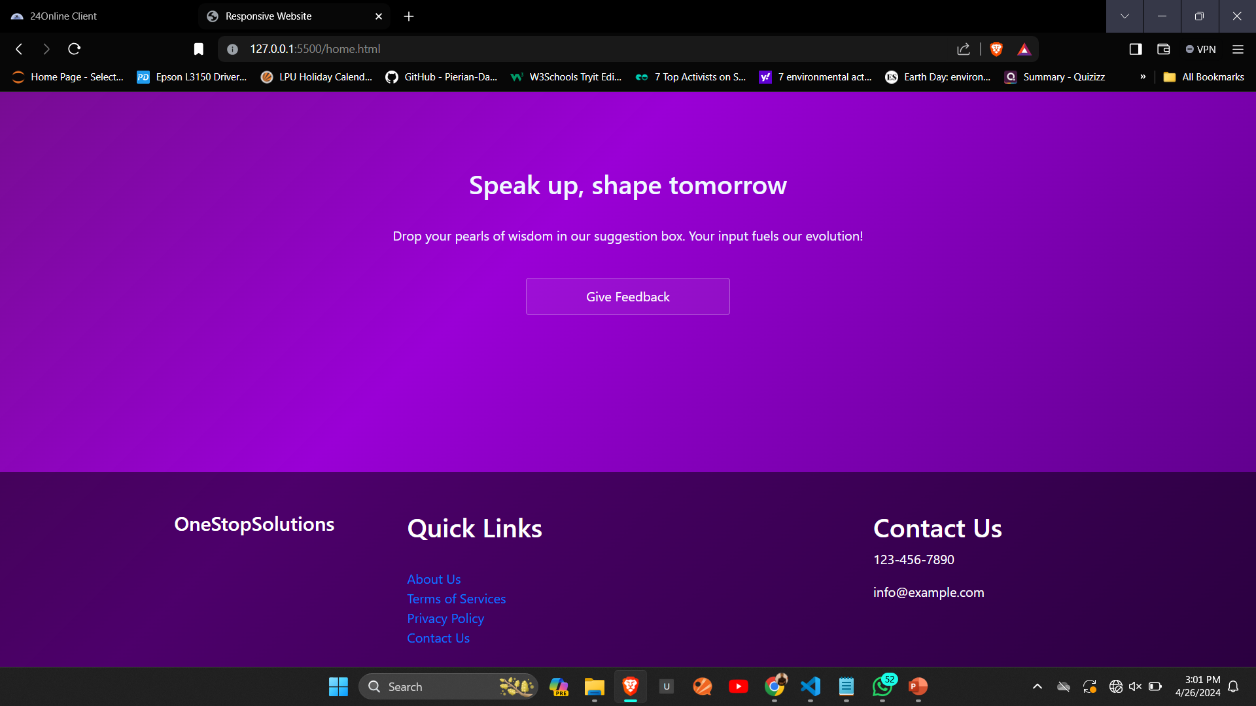

Slide 11
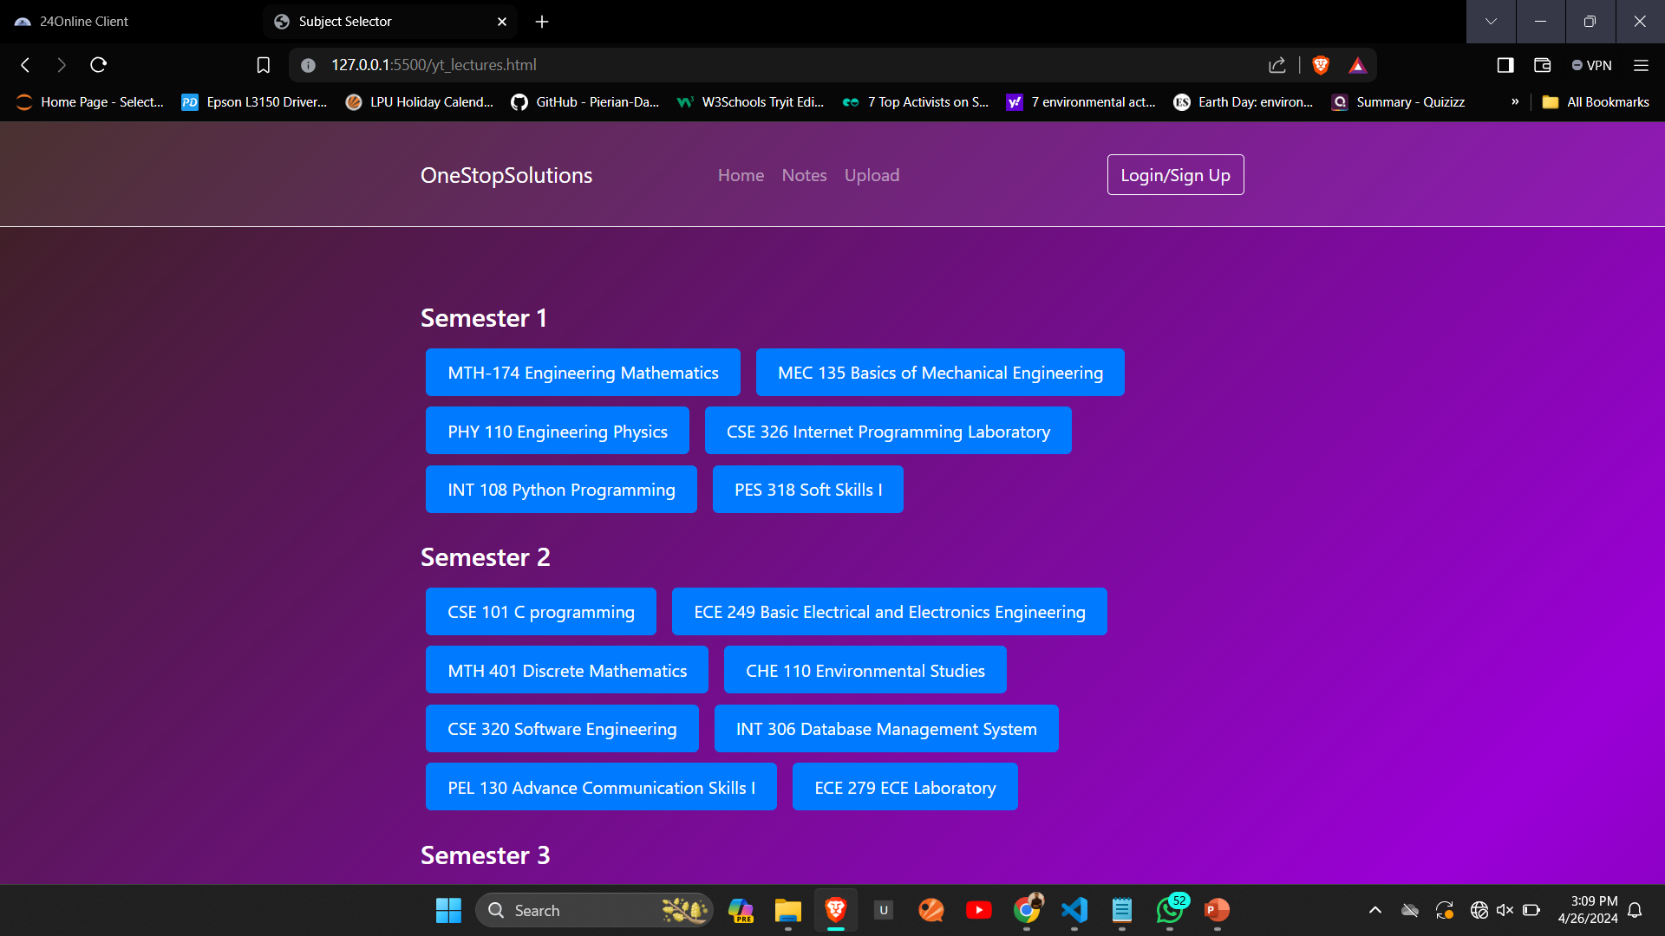

Slide 12
CONCLUSION
Just fulfilling the duty of being an Engineer !
by mean of a website named
One Stop Solutions
To make peoples live better and easy through technology.

Slide 13
THANK YOU !

